Slide 1
The 2019 Calico Challenge
By
Dominic Mills-Howell

Slide 2
My project consisted of developing a web scraper aptly called scrappi.

Slide 3
Basic features
Be able to scrape from a number of different websites.
Curate the data by HTML tags.
Feature to search through scraped data.
Schedule the scraper to scrape at regular intervals.

Slide 4
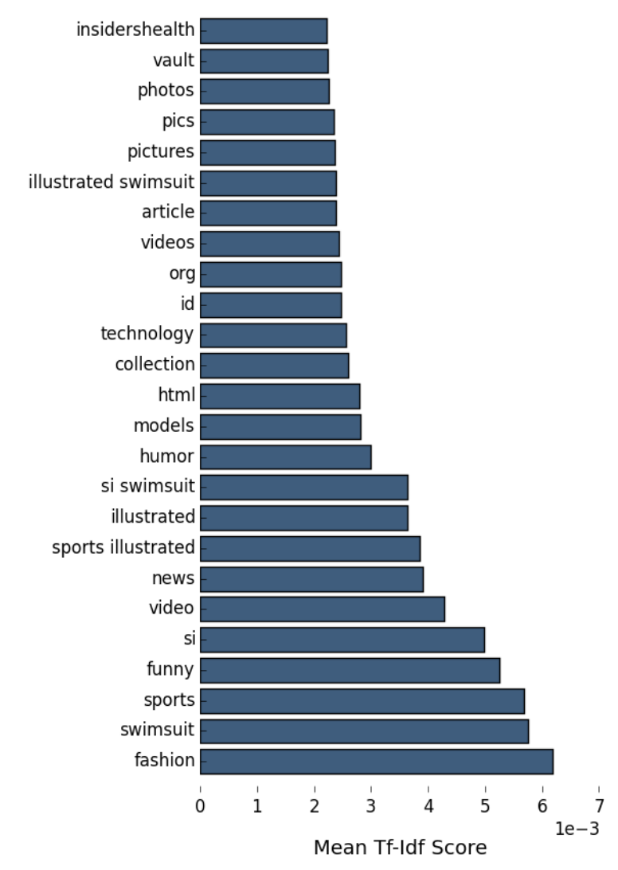
I realised that these features fit nicely within the framework of tf-idf analysis. tf-idf stands for term frequency–inverse document frequency. It measures the importance of a word is a document relative to a body of documents (corpus)
Applications are in text (data) mining, user modelling and sentiment analysis.
This has straightforward uses in business, social sciences, etc. Since it lets you understand your user on a deeper level though just their speech/text. For example, scraping the reviews section of an amazon item can help to understand what people like about a product based on the occurrences of a certain word.

Slide 5
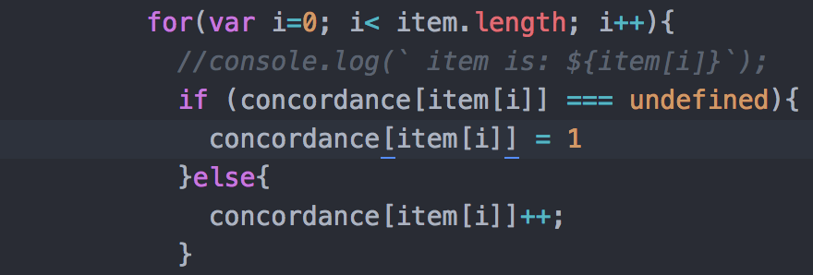
Our methodology
Start with a scraper that scrapes a single website and generalise it to multiple websites. For the single scraper keep, a tally of the number of times a given word occurs. The technical term for our word count is concordance.

Slide 6
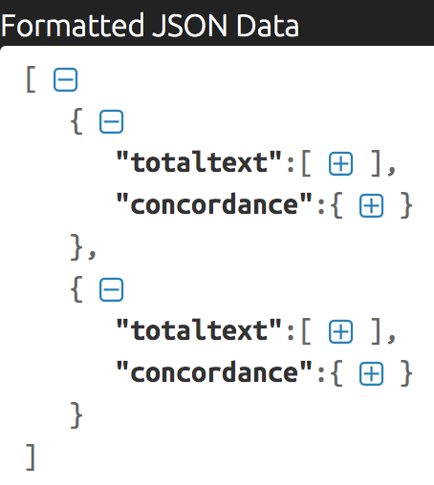
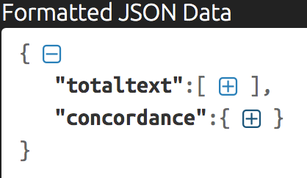
The output will be saved as a JSON object and we have enabled a feature for it to be exported. The structure of the JSON file is as follows: for multiple scraped sites it is an array of JSON objects that contains the individual words and the respective times they have occurred.

Slide 7
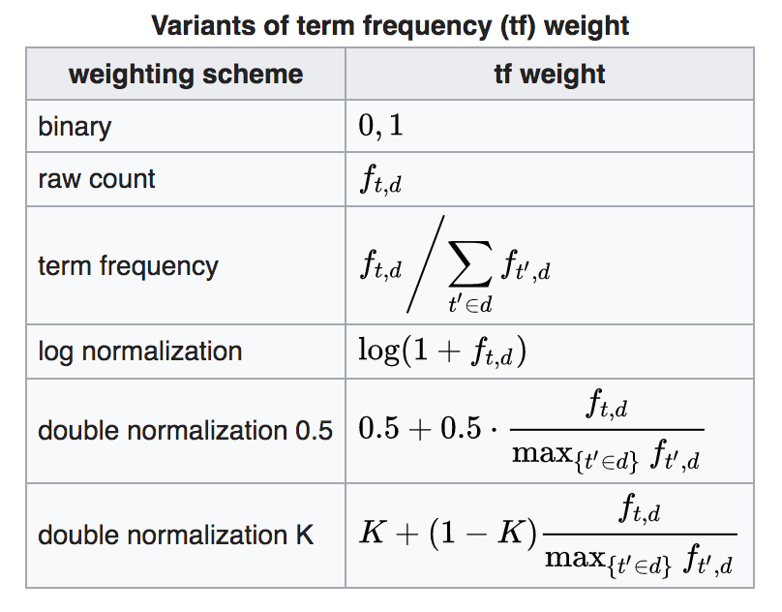
IF-TDF
Now that we’ve defined a scraper that contains the text and word count then the next thing to do is to do the relevant calculations using the id-tdf.
There are a number of ways to define the weights for the if-tdf.

Slide 8
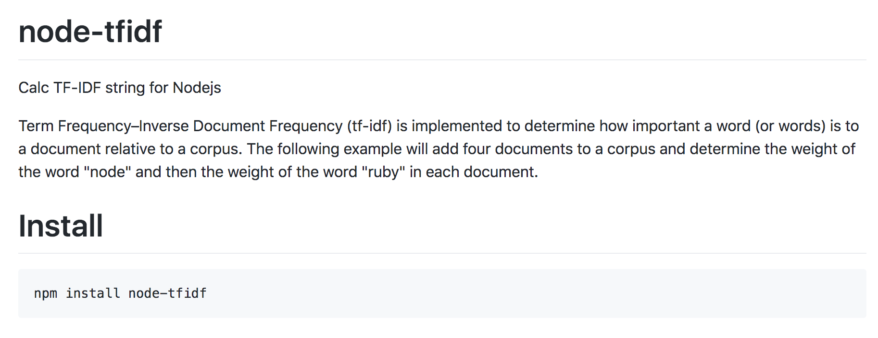
Fortunately for us, a Node.Js library (node-tfidf) that calculates the tf-idf is readily available.

Slide 9
All of the aforementioned features work nicely under the context of tf-idf and serves to enhance it in various aspects.
The schedule scraper feature enables us to accumulate real time data from sites such as twitter, reddit etc.
The curated data feature allows us to view the important words on specific sections of the website, such as the comment section on Amazon.

Slide 10
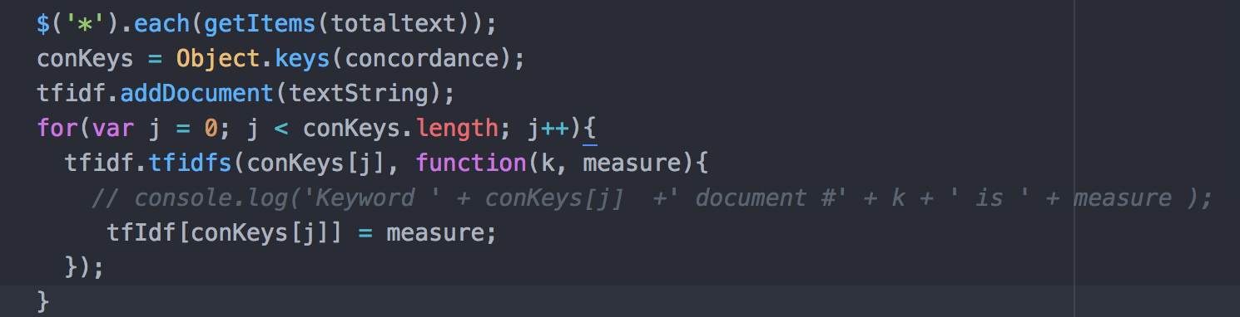
The above code snippet shows how one can use the JQuery-esque selectors from the cheerio library to sift through the text from the various HTML elements.

Slide 11
Advanced features
Visualising the scrapped data through integration with a plotting library.
Exporting the scraped data to a .json/csv file.
Comparing two websites based on similarity of scrapped data.

Slide 12
The last feature, at the time, is what inspired using the tf-idf framework. Since it ultimately provides a metric to compare how similar or different two websites are by the word frequencies.

